Slide 2
Assignment instruction link (display whole directory contents)
https://www.dj4e.com/assn/dj4e_html.md

Slide 3
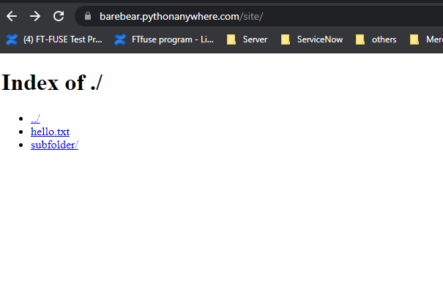
Final result

